Slide 1

Quadrature Down Converter
AIKYA ORUGANTI | INDIRA C REDDY
2023102062 | 2023102070

Slide 2
Introduction
The Quadrature Down Converter is a crucial component in wireless communication systems, responsible for extracting the in-phase and quadrature phase components of a received message signal.
The circuit consists of the following three sub-circuits: 1.Quadrature oscillator – to produce two orthogonal sinusoids 2. Switch or Mixer – to multiply the oscillator sinusoid with the input signal 3. Low-pass filter – to attenuate the high frequencies giving the desired base-band signals as output

Slide 3
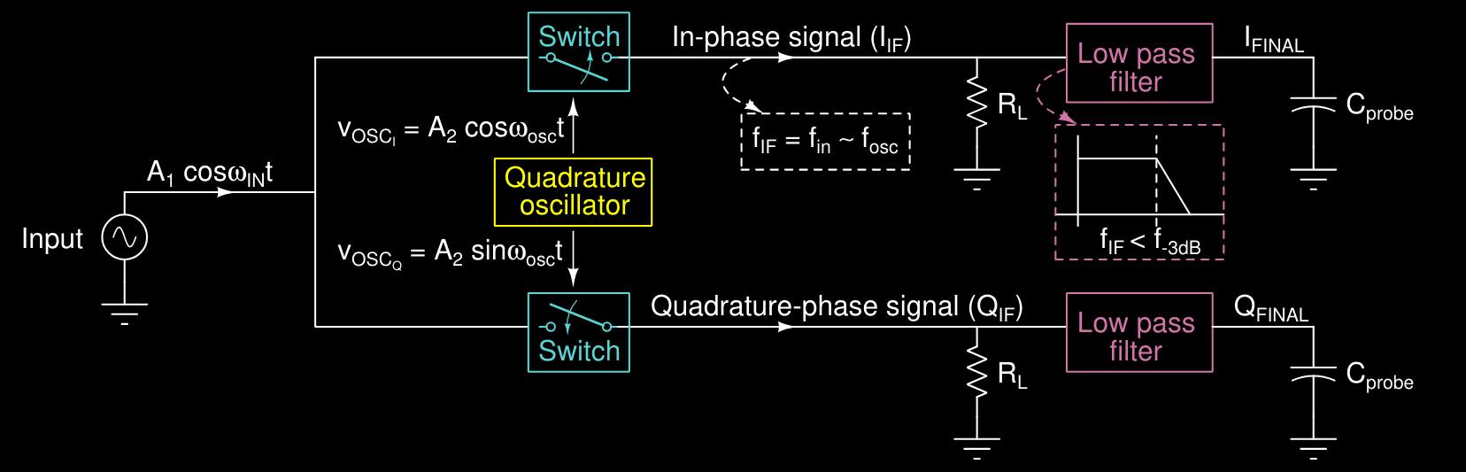

Slide 4
Quadrature Oscillator
The Quadrature Oscillator generates the required sine and cosine waves. It ensures accurate phase and frequency synchronization for the Quadrature Down Converter operation.
In our design, we require a 90° phase shift between the two generated sine waves, each having an amplitude of 1 Vpp and frequency of oscillation 100kHz.
To achieve this, we have implemented the following quadrature oscillator circuit: R1C1 = R2C2 = R3C3 = RC where R = 390Ω and C = 1nF.
The frequency of oscillation can be calculated using the formula: f = 1/2πRC

Slide 5
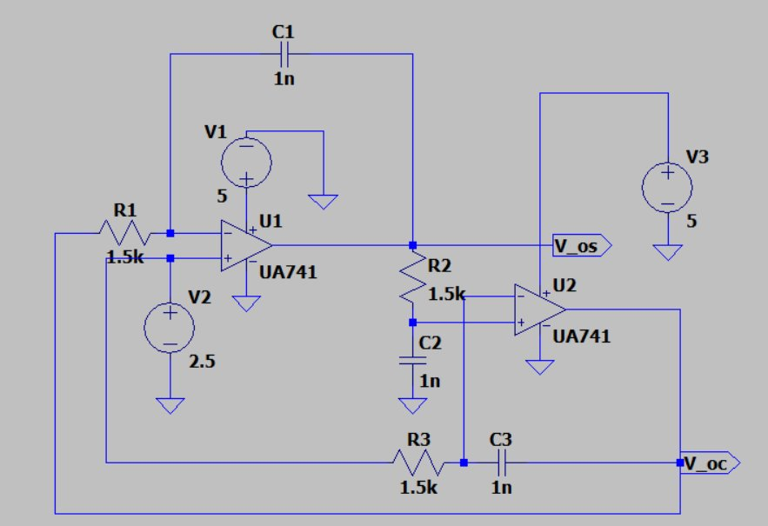
Topology used

Slide 6
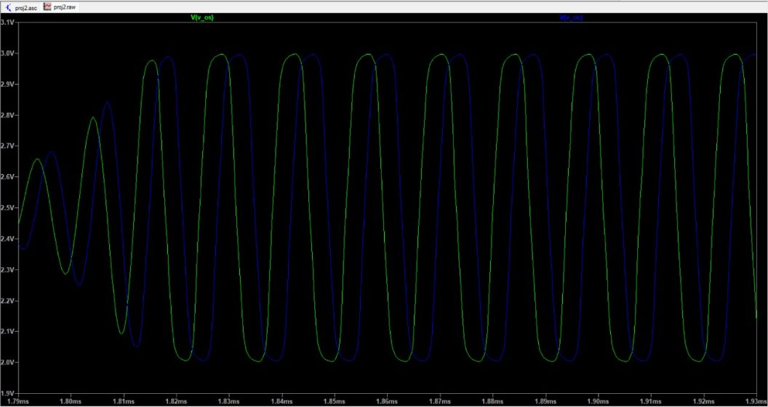
Simulation on LTSpice

Slide 7
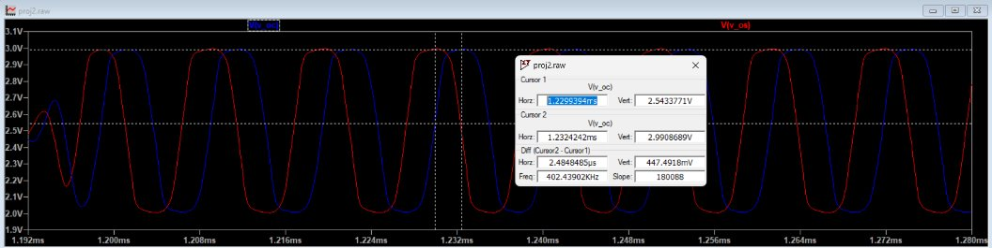
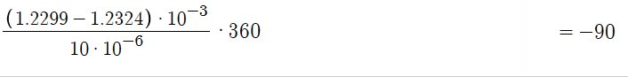
Calculating the phase difference of two sinusoids
We calculate the phase difference of the two sinusoids by taking the horizontal distance between their corresponding peaks, dividing that value by the period of the sinusoid and multiplying that 360°.​
Phase:

Slide 8
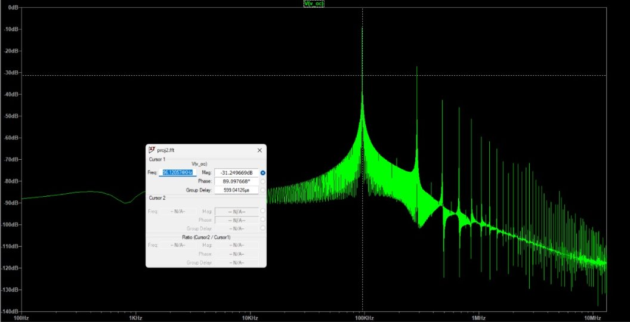
FFT
First peak is at 96kHz which is close to the decided frequency(100kHz). At higher harmonics, the wave is clipped. To avoid this we use a low pass filter.

Slide 9
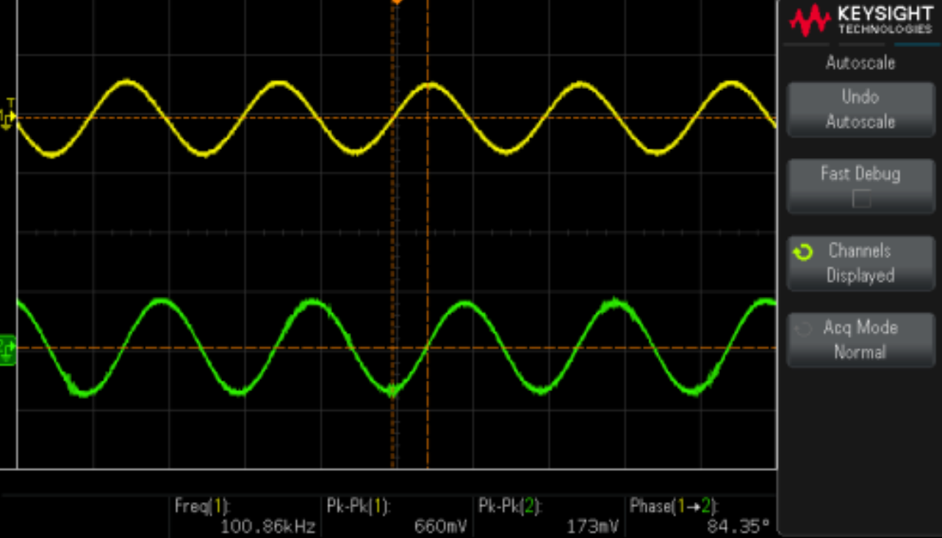
DSO Output

Slide 10
Switch(mixer)
The mixer multiplies the input signal with one of the sinusoidal oscillations given by the quadrature oscillator.
We use an NMOS switch biased to remain in the saturation region, with the received signal connected to the source and the oscillator input connected to the gate
V_TH of nmos4: 0.38 so we choose a VBIAS of 0.375(for MOSFET to be in saturation)---(VGS>=VTH; VDS>=VGS-VTH)
R=5MΩ, C=20pF
We connect resistor to prevent the DC source from acting as AC ground and a capacitor to prevent the oscillator circuit from behaving as DC short
RL = 1 kΩ, V_in=100mV(given)
V_osc=500mV, f_osc=100kHz(output from oscillator)

Slide 11
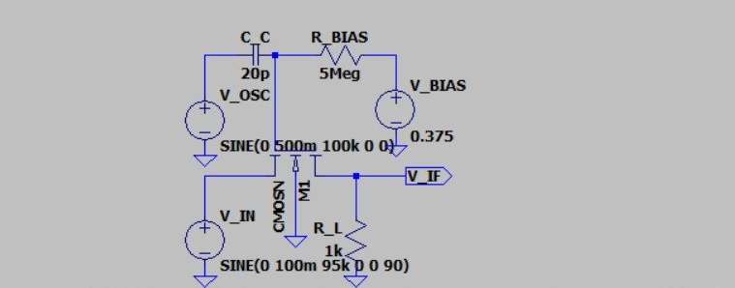
Topology used

Slide 12
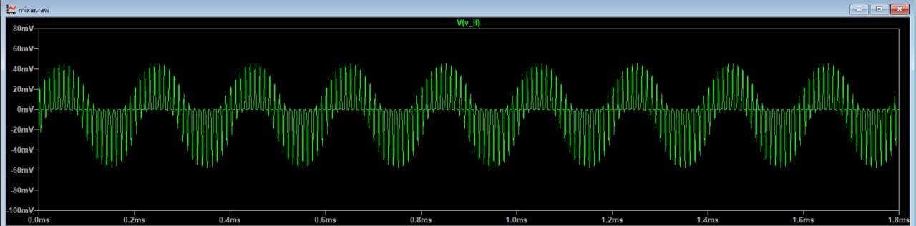
Simulation on LTSpice
F=95kHz​

Slide 13
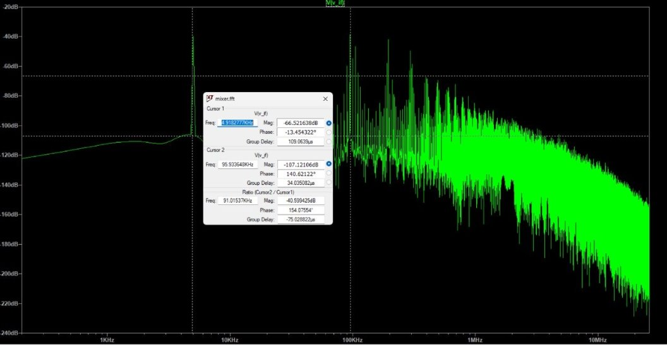

Slide 14
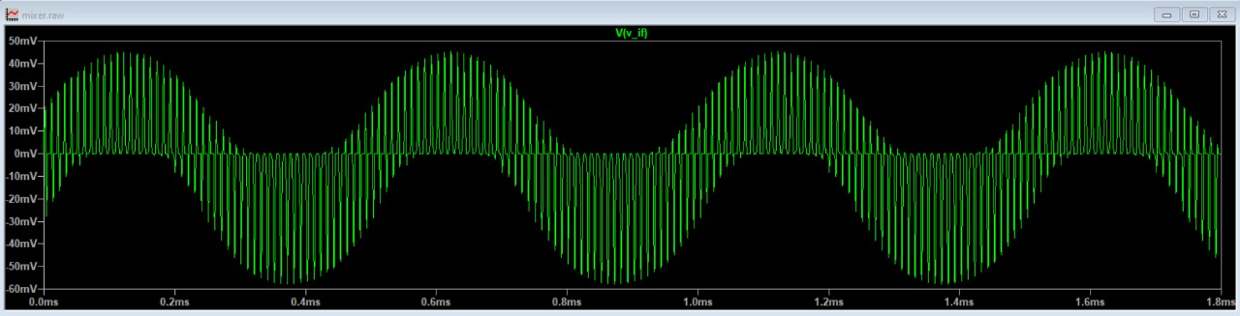
F=98kHz

Slide 15
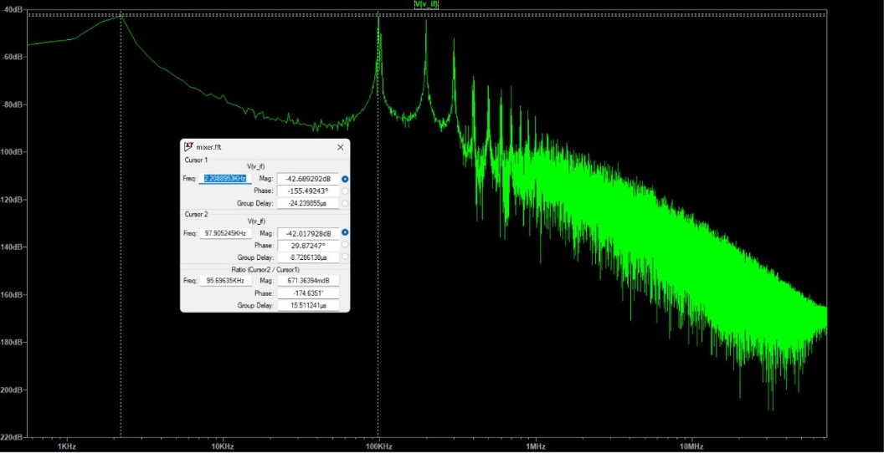

Slide 16
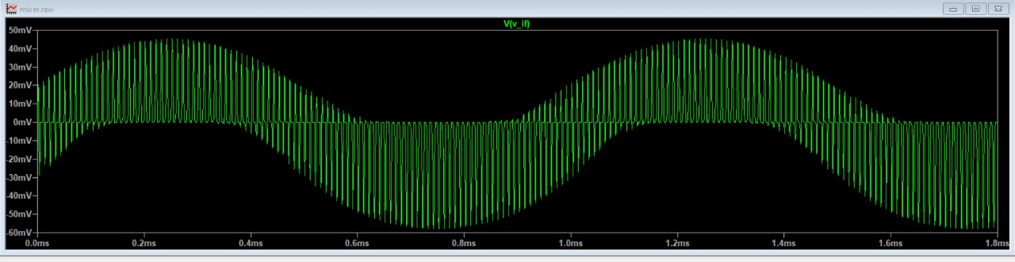
F=99kHz

Slide 17
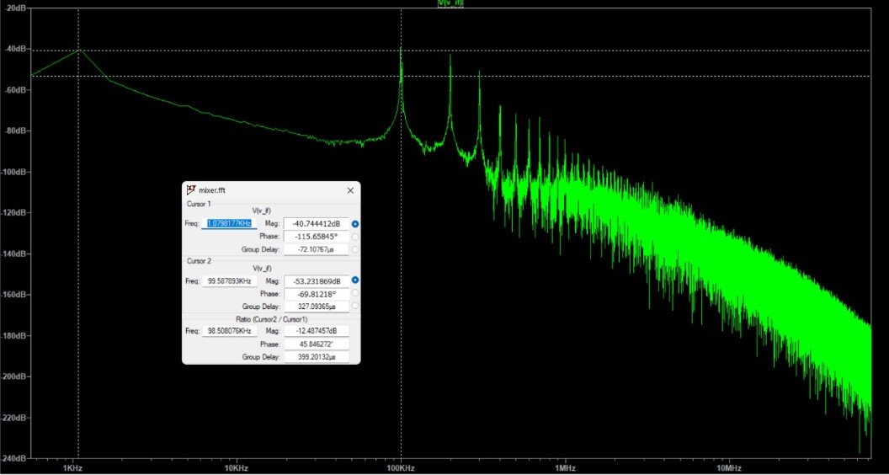

Slide 18
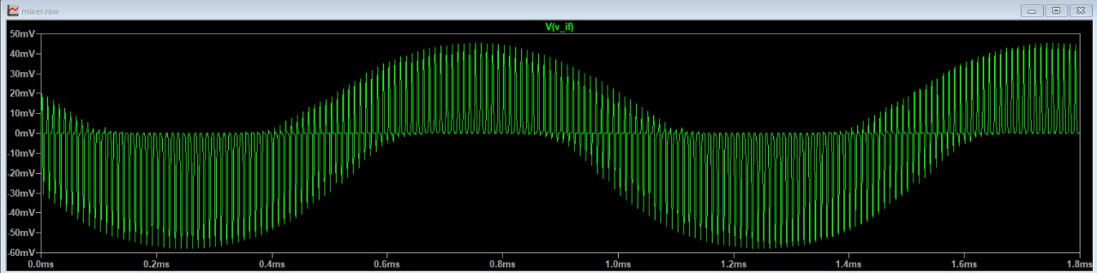
F=101kHz

Slide 19
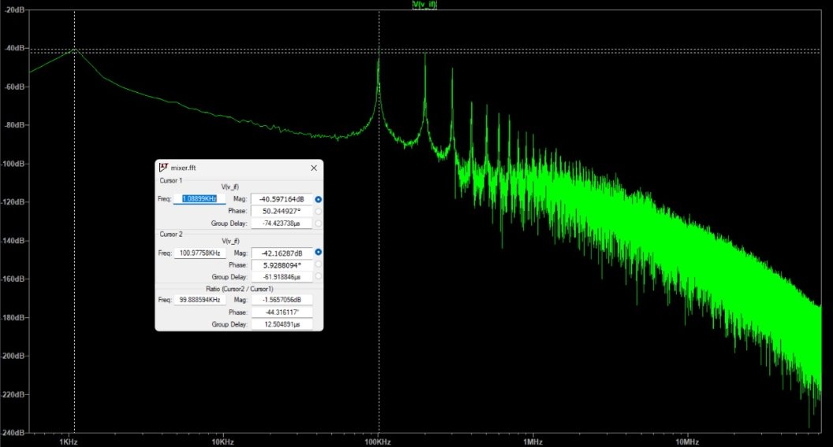

Slide 20
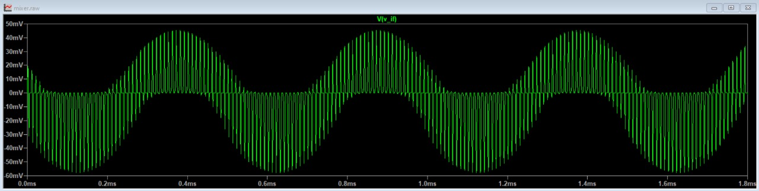
F=102kHz

Slide 21
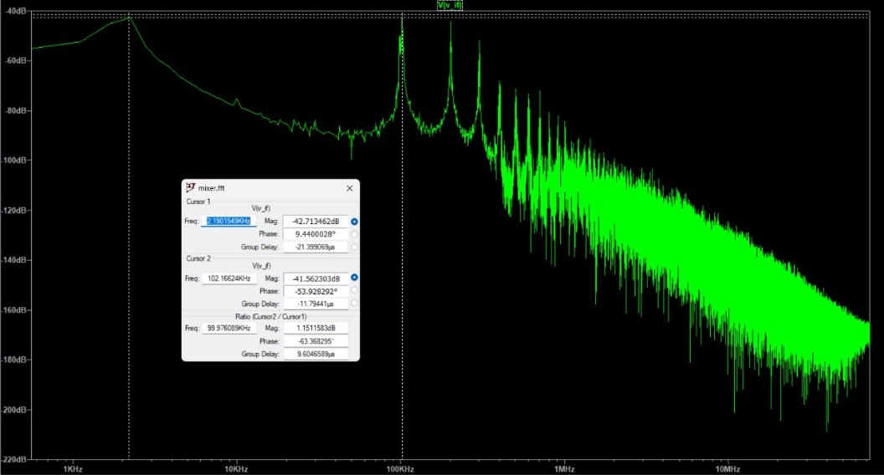

Slide 22
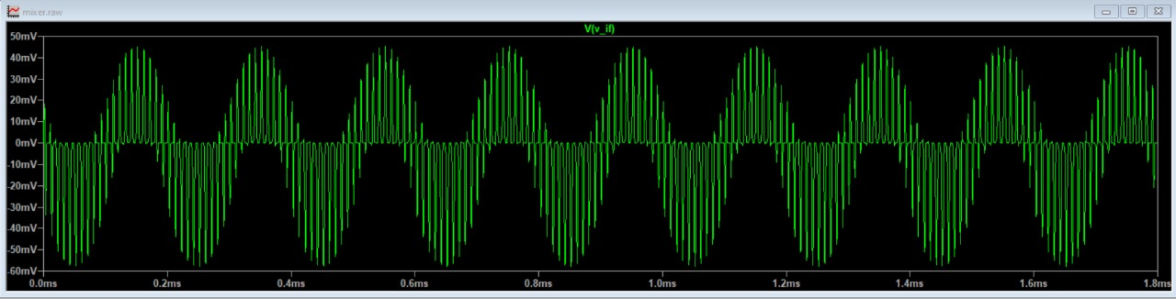
F=105kHz

Slide 23
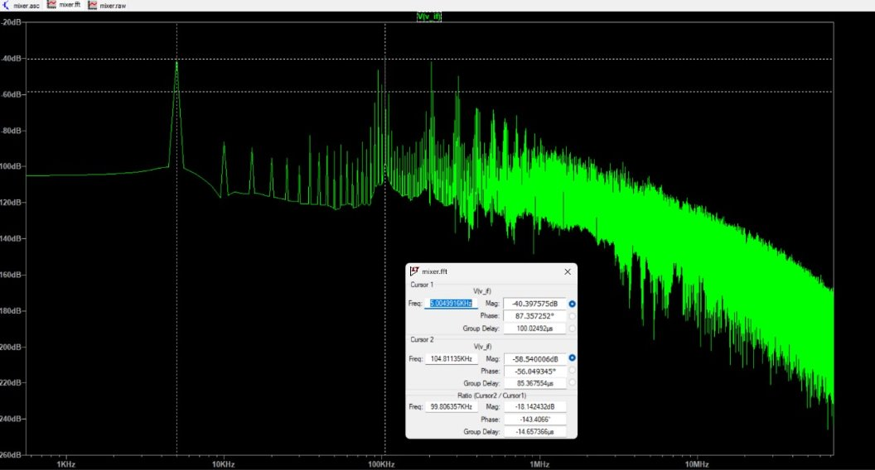

Slide 24
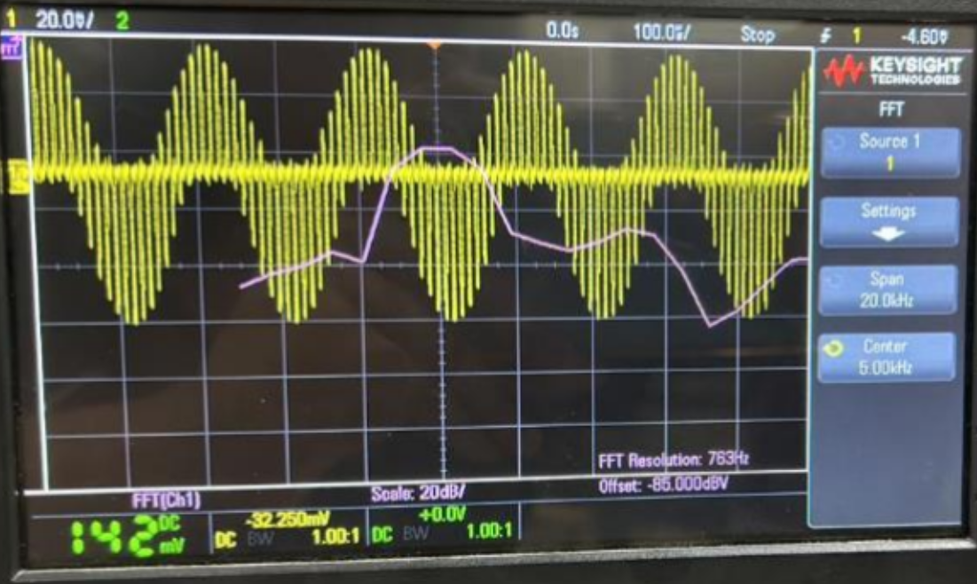
DSO Outputs
For input signal frequency = 95kHz

Slide 25
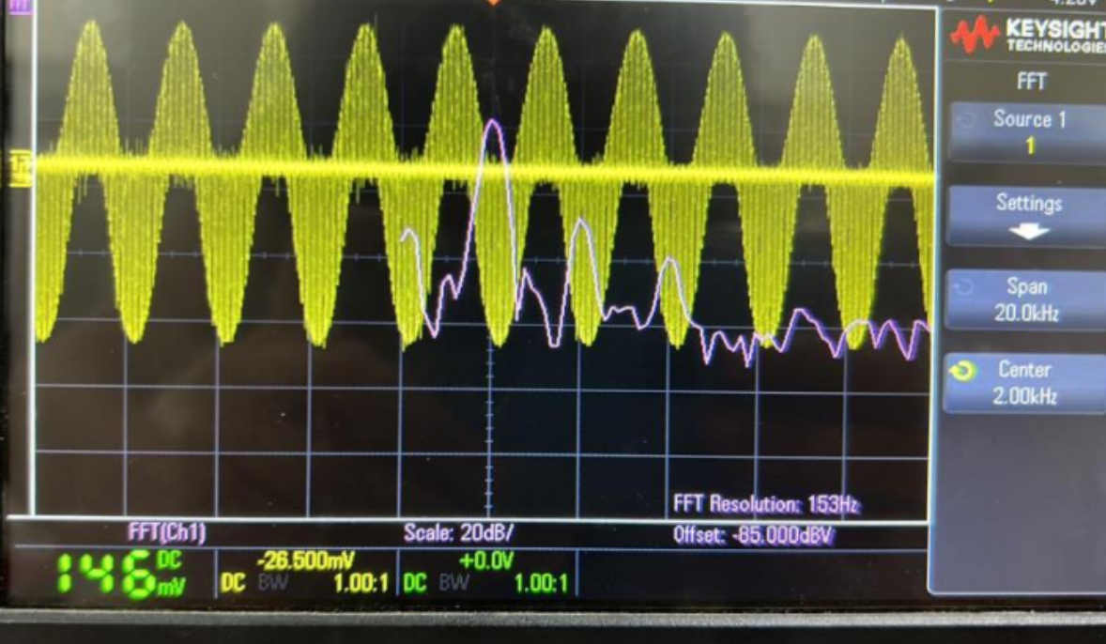
For input signal frequency = 98kHz​

Slide 26
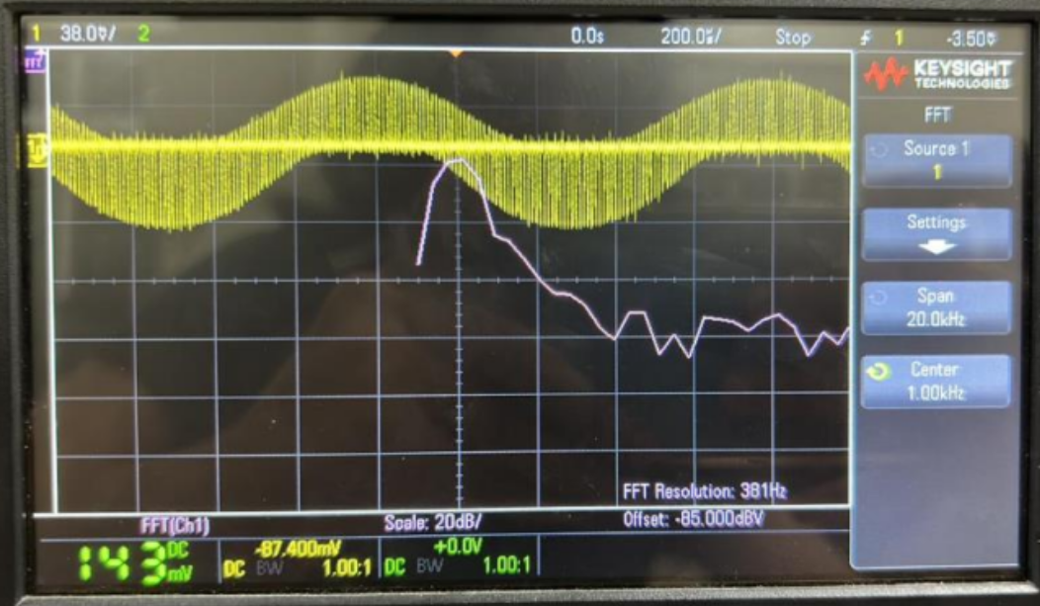
For input signal frequency = 99kHz​​

Slide 27
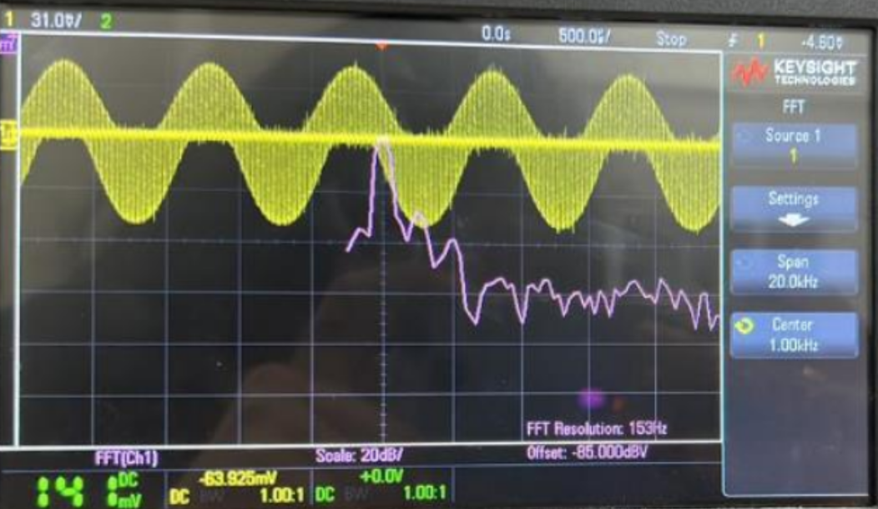
For input signal frequency = 101kHz​​​

Slide 28
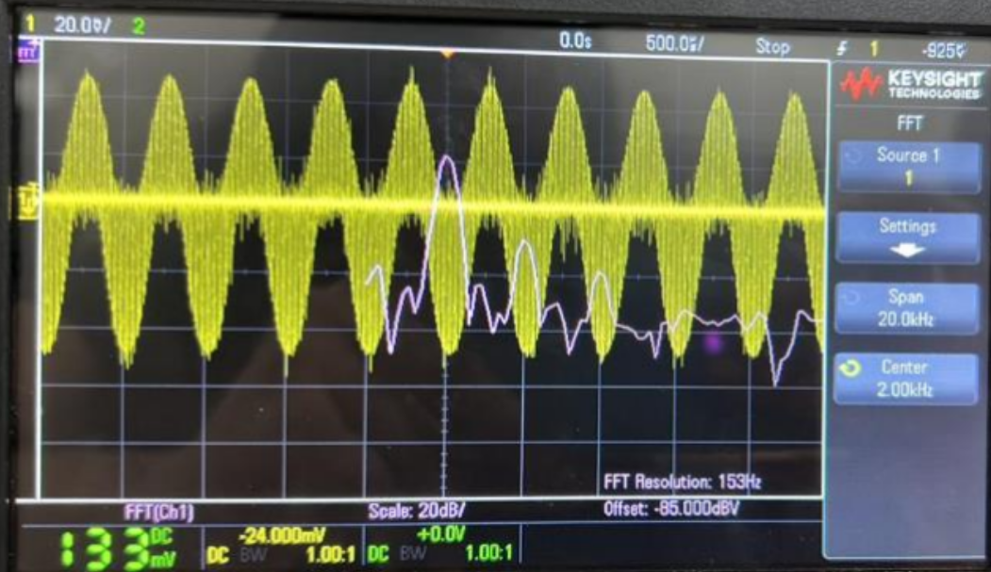
For input signal frequency = 102kHz​​​​

Slide 29
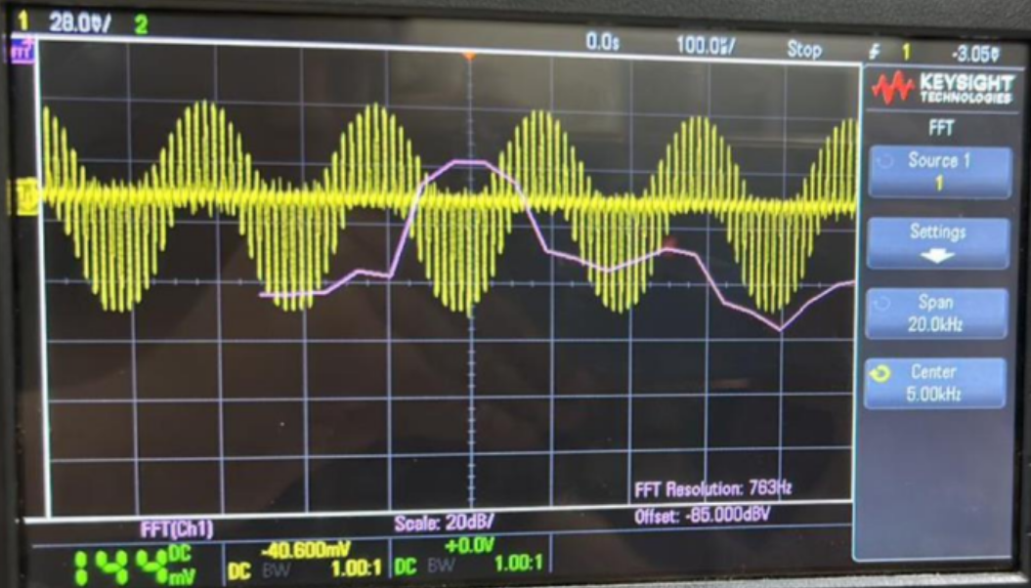
For input signal frequency = 105kHz​​​​​

Slide 30
Low Pass Filter
A low pass filter is a filter that passes signals with frequency lower than a selected cutoff frequency and attenuates signals with frequencies higher than cutoff frequency.
In general since we receive a signal which has both low frequencies and high frequencies, we use a low pass filter to attain the required low frequency signal.
We design a simple RC low pass filter such that the cutoff frequency is greater than the required frequency and less than the higher frequency.
Cutoff frequency lies between first peak and second peak of the output of the mixer circuit
Since cutoff frequency of a simple RC filter f = 1/ 2πRC ,
We have selected -3dB frequency to be 2 kHz, we take R and C values as R = 7957.75 Ohm and C = 10nF.

Slide 31
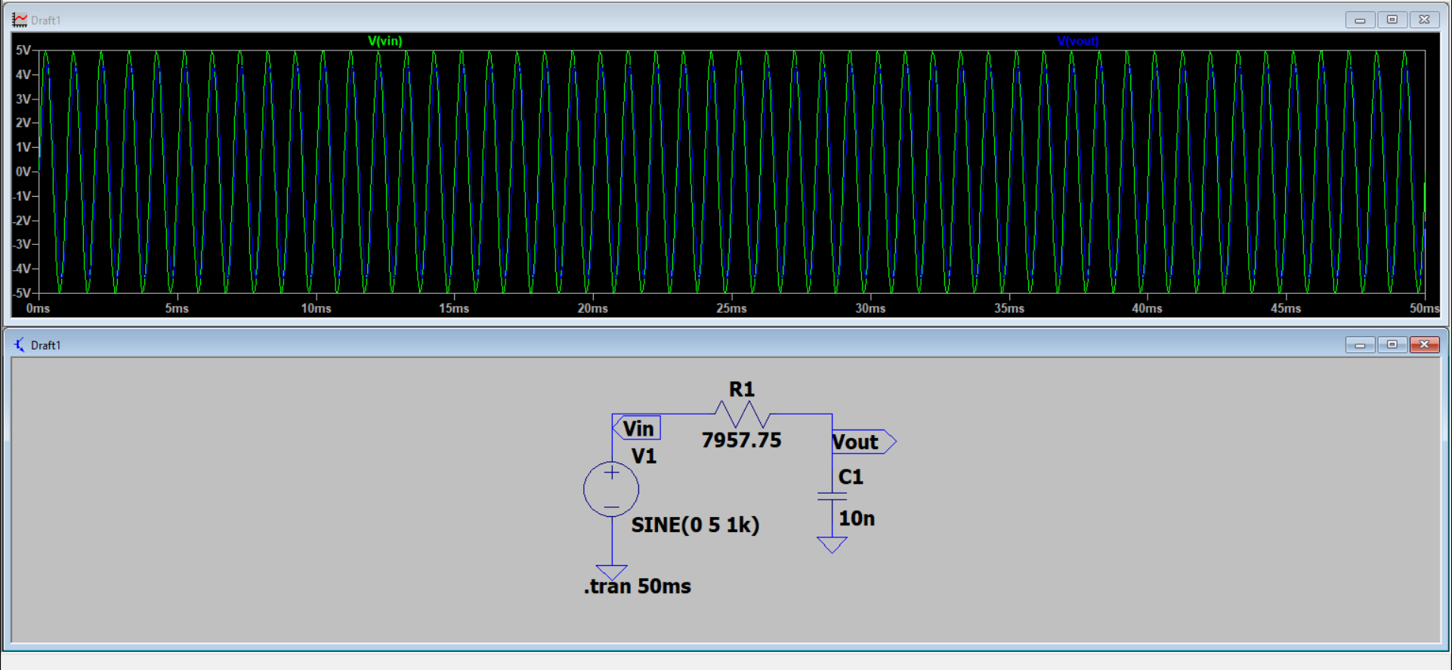
Transient analysis for frequency 1K

Slide 32
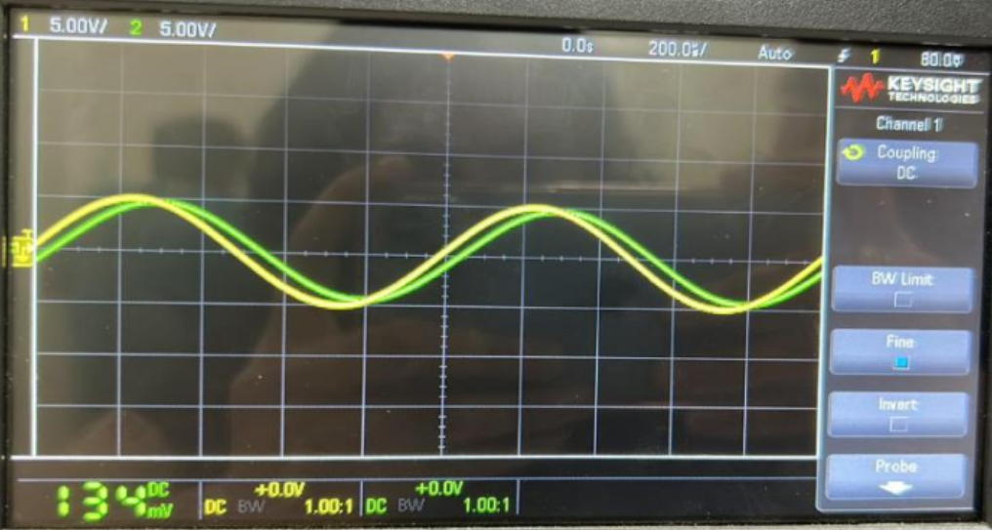
DSO Output​

Slide 33
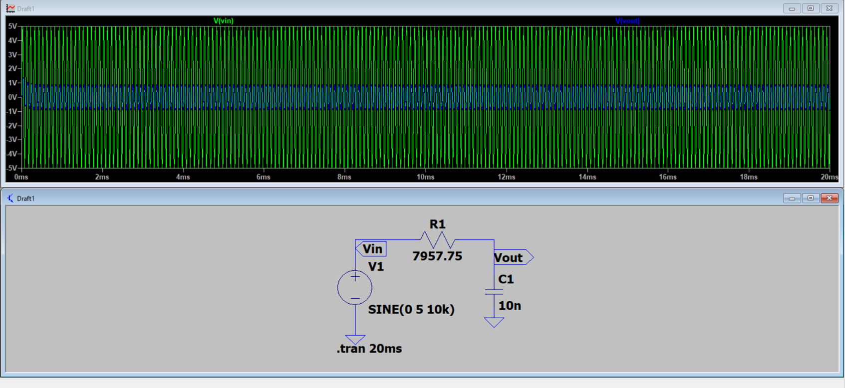
Transient analysis for frequency 10K

Slide 34
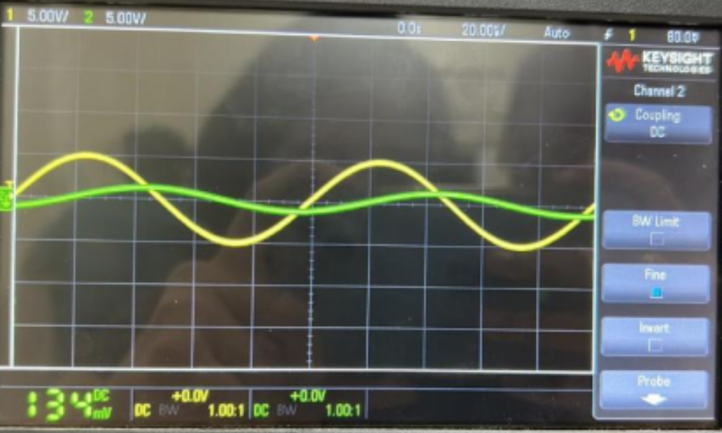
DSO Output​

Slide 35
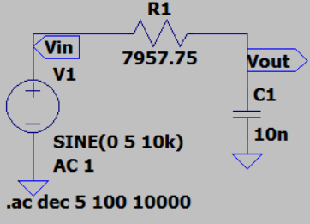
AC Analysis

Slide 36
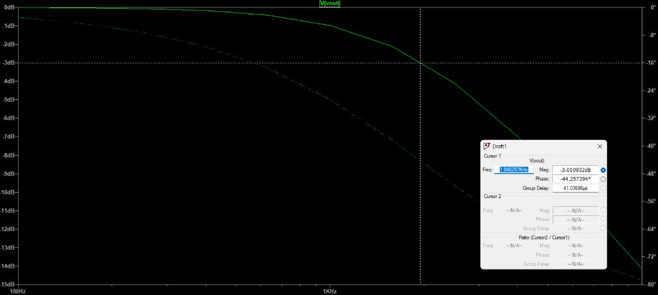

Slide 37
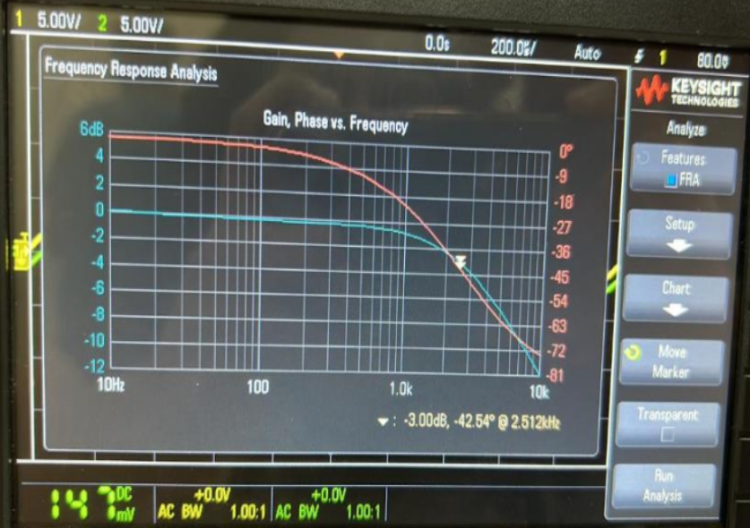
Frequency response observed on DSO

Slide 38
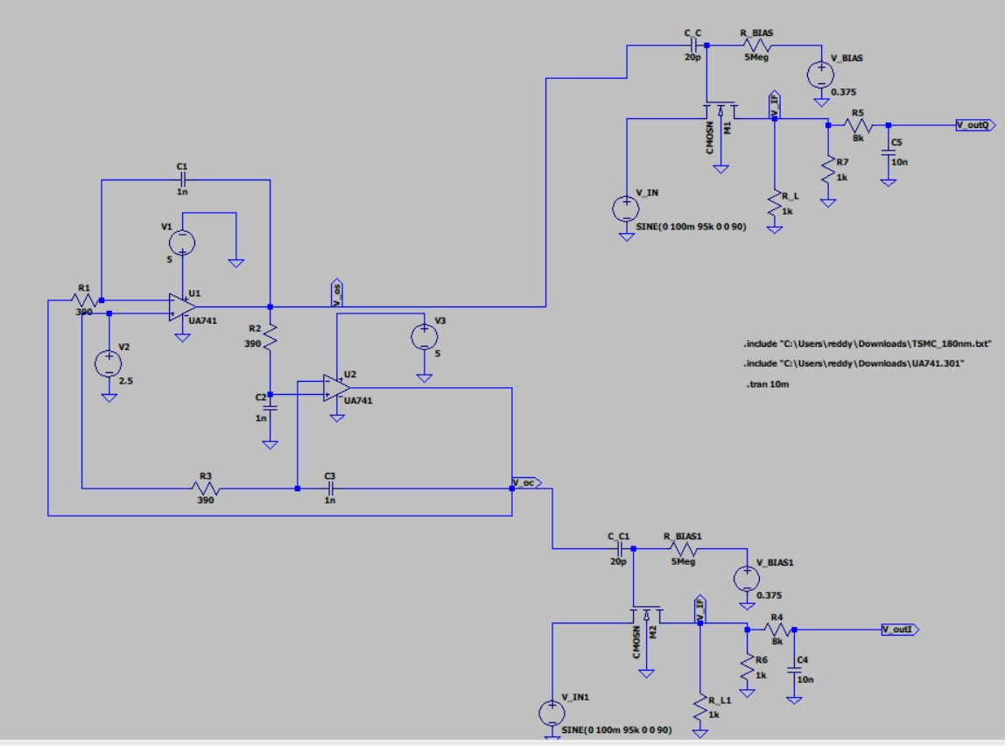
Complete Circuit Integration

Slide 39
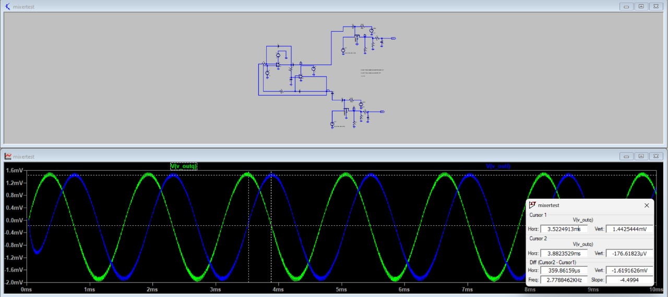
Phase difference calculation

Slide 40
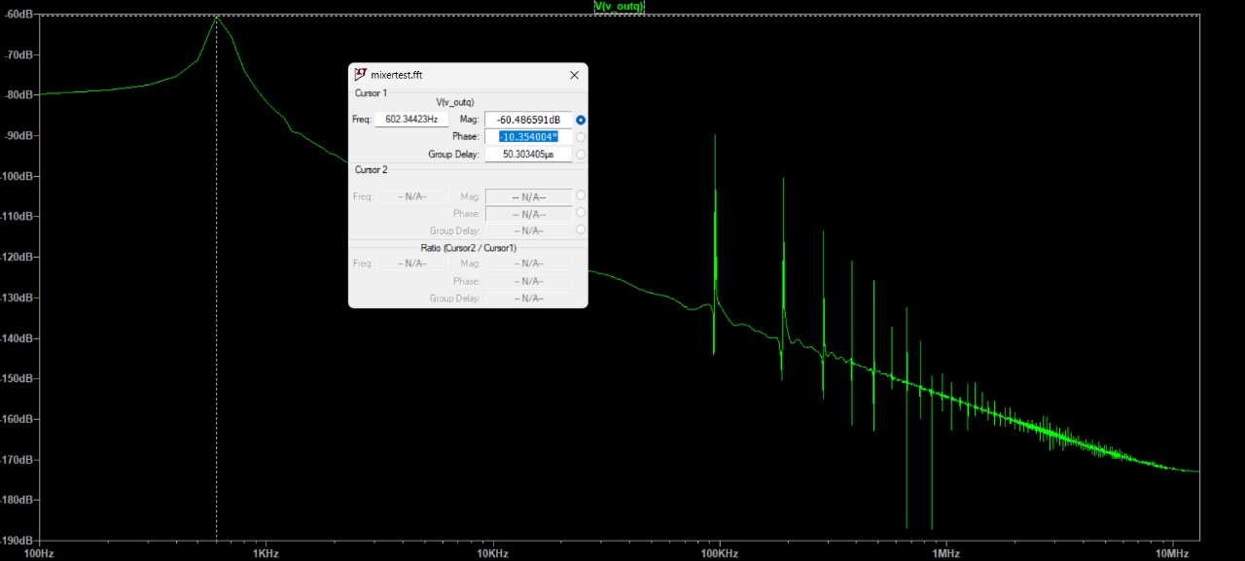
FFT-Q

Slide 41
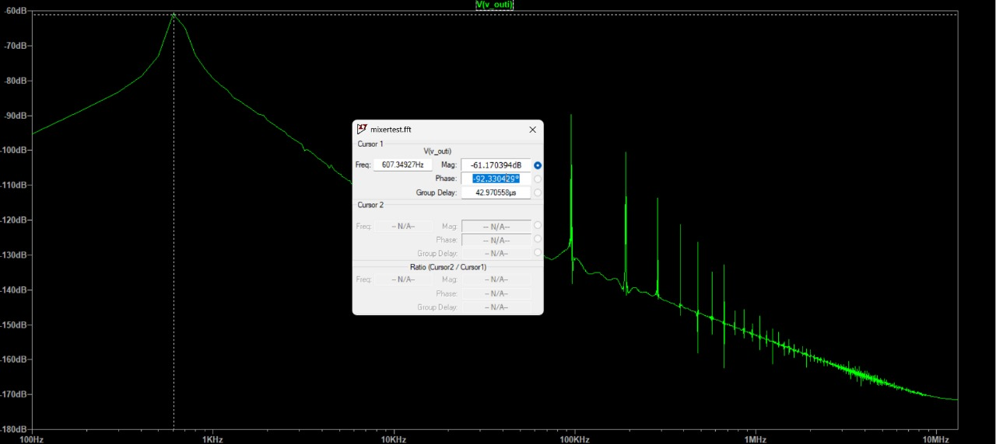
FFT-I

Slide 42
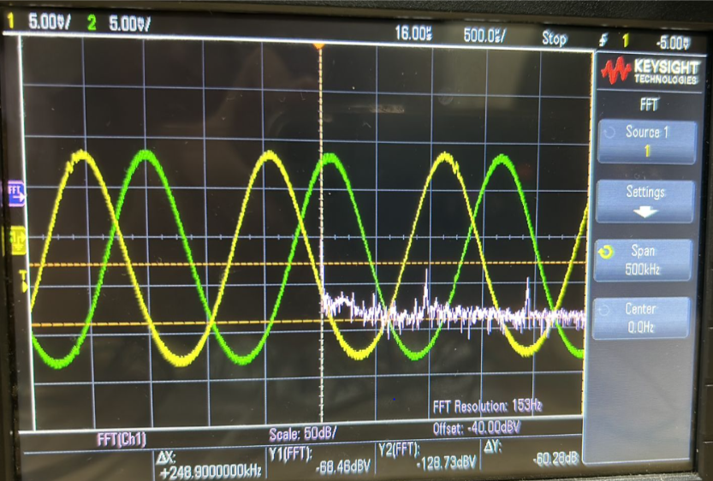
DSO outputs: With FFT and pointing to the peeks

Slide 43
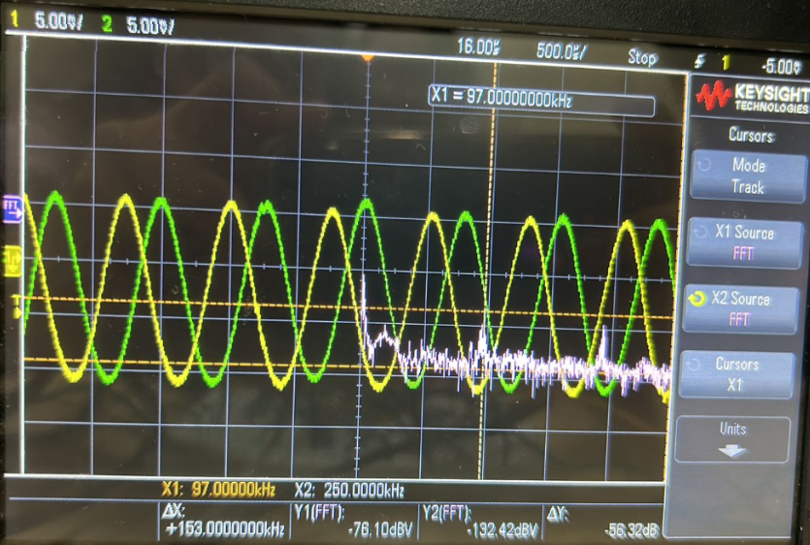

Slide 44
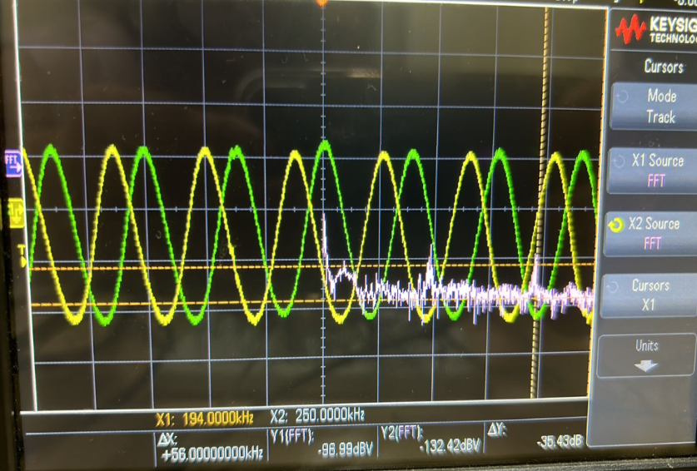

Slide 45
Local Oscillator(LO): Two LO signals that are 90 degrees out of phase with each other.
Mixers: Two mixers are required, one for each LO signal, to perform the mixing process.
Low Pass Filters: Each mixed signal needs to be filtered using a low pass filter.
Adder/Complex Mixer: A circuit is needed to combine the filtered I and Q signals.
Further Processing: Depending on your application, you may require additional components like filters, amplifiers, and analog-to-digital converters for further signal processing.
We can conclude that we got the desired output meeting above requirements
Thank You!

